Slide 1
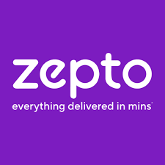
Business Case Study and Report
PRESENTED BY:
Anand S

Slide 2
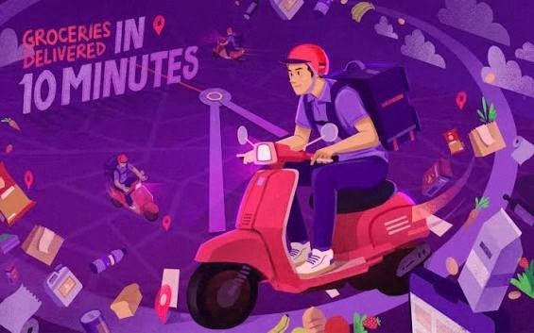
Company Overview
Business Model Analysis
Unique Selling Proposition (USP)
Market Gap & Customer Need Analysis
Technology & Innovation Study
Customer Review & Sentiment Analysis
Competitor Benchmarking
SWOT Analysis
Agenda
Key Insights & Findings
Strategic Business Recommendations
Result

Slide 3

Company Overview
  Founded - 2021
  Founders - Aadit Palicha and Kaivalya Vohra
  Industry - Quick Commerce / E-commerce
  Headquarters - Bengaluru, Karnataka, India
  40+ million users
  200+ Dark stores close to customers
  Daily essentials and other categories
  25 Minutes Delivery
Back to Agenda

Slide 4
Business Model Analysis
Zepto’s Revenue
Value to customer
Delivery Commissions
8%–25% Per Order
Advertising & Promotions
Digital advertising, influencer marketing & Social Media Marketing
  Wide Product Range – Groceries, snacks, beverages, personal care, household. items and more are available in one place.
  Real-time tracking & live updates.
  Delivered in around 10 minutes in eligible locations.
  Free delivery on Zepto Pass.
Membership
Zepto Pass
Fast Deleivery
10-min grocery delivery, Household Essentials
Key Costs of Zepto
  Dark Store Operations
  Technology & platform maintenance
  Marketing & Promotions
  Inventory Costs

Slide 5
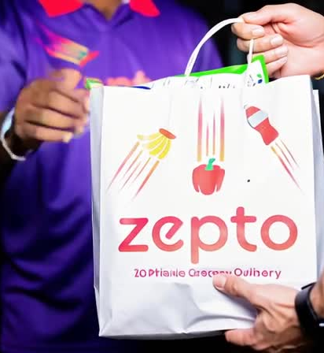
01
🌍 Largest Network
Unique Selling Proposition (USP)
1000+ dark stores as of March 2026
02
⚡Fast Delivery
Delivery in 10-min, Real-time tracking
03
🏅Subcription
Zepto Pass – Free delivery & Discounts
04
⭐Trusted Brand
Trusted Brand – Zepto /Strong Brand Recognition

Slide 6
MARKET GAP & CUSTOMER NEED ANALYSIS
Benefits
Before Zepto
After Zepto
Time saved
Limited shopping hours at physical stores
App-based ordering throughout the day
Great deals
& offers
Grocery purchases in advance.
Instant or last-minute purchases.
Better choices
Shopping 30–60 minutes
Delivered within minutes
Easy Price Comparison
Customers carried groceries home themselves.
Products are delivered to the customer's doorstep
Convenient
Store offers
App-based offers, coupons and promotions.

Slide 7


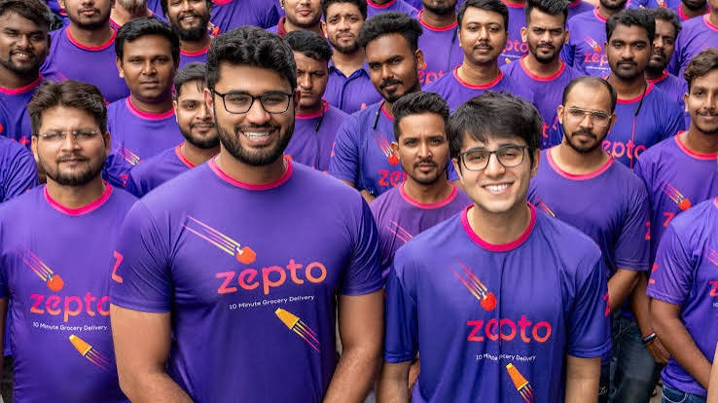


Technology & Innovation Study
Real-Time Tracking
AI & Machine Learning
Data Analytics
Mobile App & Website

Slide 8


CUSTOMER REVIEW & SENTIMENT ANALYSIS
Positive Reviews | = Neutral Reviews | Negative Reviews
Fast delivery and time-saving | Product availability can vary by location | Late deliveries in peak hours
Convenient doorstep delivery | Prices and additional charges may differ from traditional stores | High delivery fees
Easy-to-use mobile app | Average customer support | Refund or customer-support experiences may vary
Wide range of products |  | Order Cancellation
last-minute purchases

Slide 9





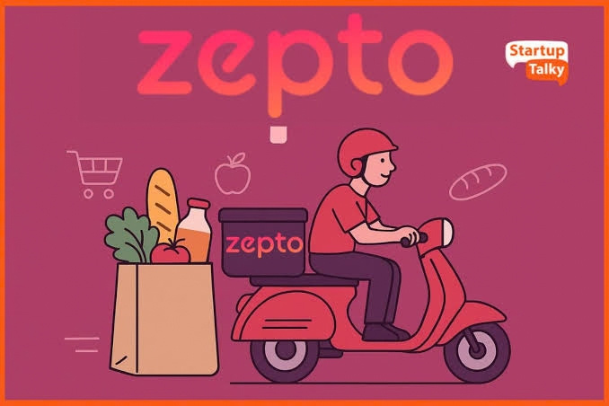




COMPETITOR BENCHMARKING
Comparison Criteria
Zepto
Blinkit
Swiggy Instamart
Flipkart
Delivery Time
10 - 13 Minutes
15 Minutes
10 - 15 Mintues
10 - 15 Mintues
App Rating
4.7 ⭐
4.7 ⭐
4.6 ⭐
4.6 ⭐
Membership
Zepto Pass
Bistro/loyalty offers vary
Swiggy One / One Lite
Flipkart Plus
Avg Delivery Fee
₹30
₹45
₹40
₹50
Grocery, beauty, lifestyle, electronics, etc
Grocery, household, electronics
Grocery, electronics, beauty, fashion
Groceries + wider e-commerce categories
Product Range

Slide 10
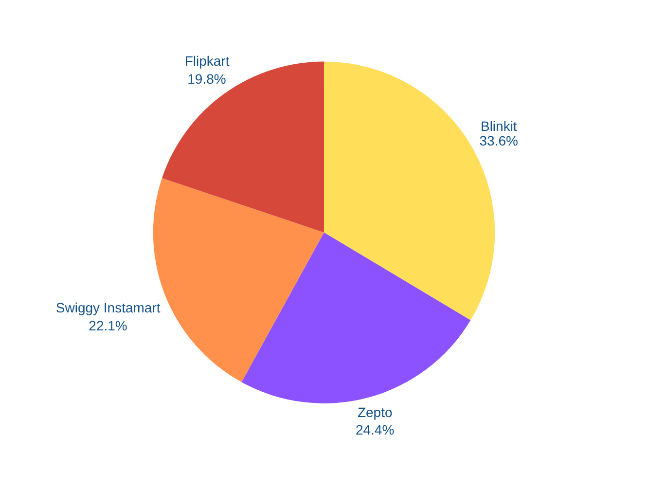

Market Share Comparison
E-Commerce Market share
BLINKIT
ZEPTO
FLIPKART MINUTES
SWIGGY INSTAMART

Slide 11

S
W
WEAKNESSES
STRENGTHS
  High operating and delivery costs
  Product availability can vary by location
  Customer experience can vary by order
  Fast and convenient delivery
  Extensive dark-store network
  Strong brand recognition
O
T
THREATS
OPPORTUNITIES
  competition from Blinkit and Instamart
  Price competition and discounting
  Customer switching between competing apps
  More India cities
  Increasing digital payments
  Expansion into electronics, beauty, apparel and lifestyle

Slide 12




Key Insights & Findings
Top Strengths
Key Problem
VS
Strong customer adoption
Customer support
Zepto's App Store listing has 4.7/5 from around 1 million ratings
01
Recent reviews include complaints about difficulty resolving missing, damaged or incorrect orders and delays in refunds/support responses
High operational efficiency
02
High operating requirements
Orders per dark store increased from 1,325/day in FY24 to 1,677/day in FY26
Maintaining dark stores, inventory and rapid delivery
Large fulfilment network
Product quality
Zepto had 1,139 dark stores at the end of FY26
03
Some customers have reported regarding the freshness or quality of fruits, vegetables and other products.
Broad product
Profitability
Zepto's app currently lists 200,000+ products
04
Zepto's rapid expansion continues to require substantial investment. Business Standard reported an adjusted EBITDA loss of ₹1,247.5 crore in Q4 FY26

Slide 13
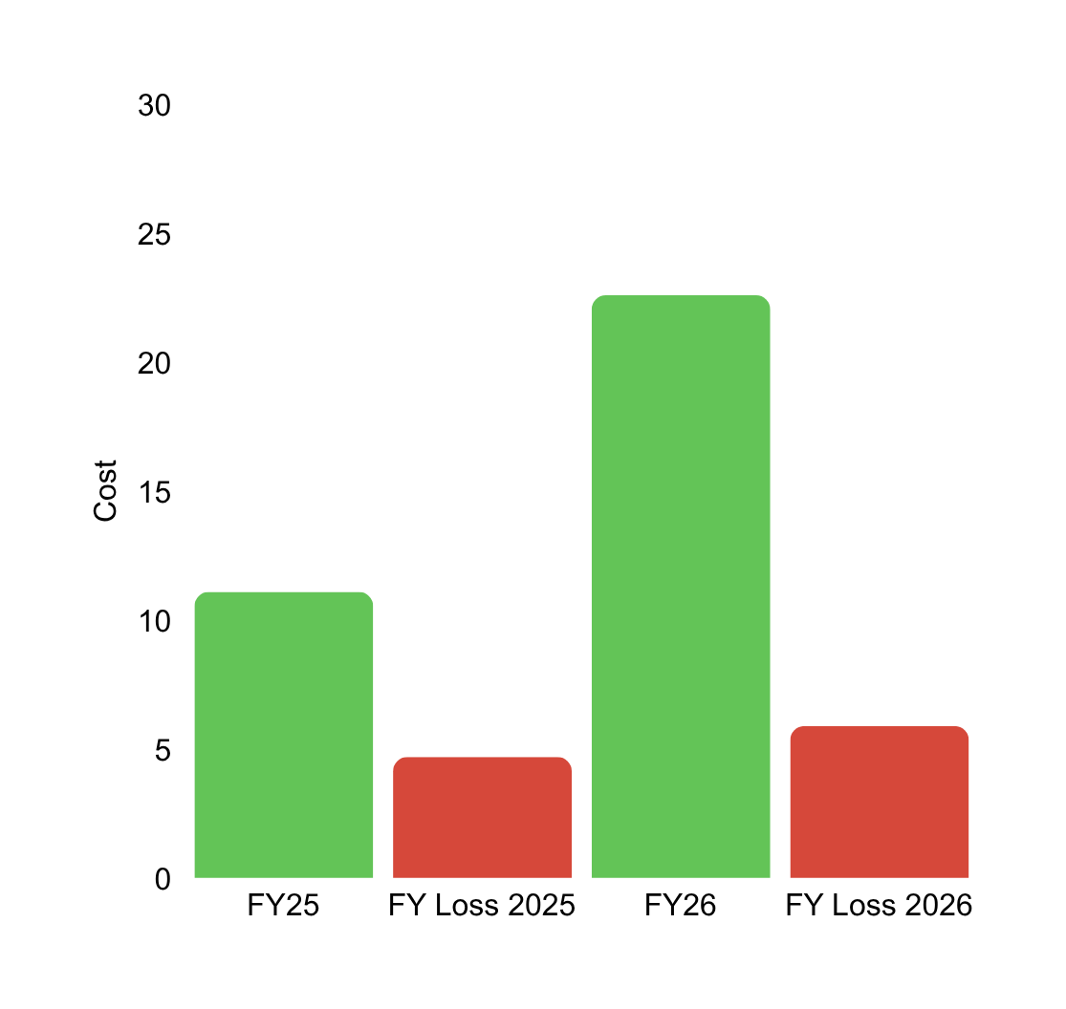

1
Growth
  Quick Delivery
  Technology & Data
  Attractive Offers

Slide 14






Strategic Recommendations (0 - 12 Month)
IMPROVE DELIVERY CONSISTENCY
STRENGTHEN CUSTOMER SUPPORT
Improve Product Availability
Reduce delays and improve ETA accuracy
Faster resolution of refunds, missing and damaged orders.
Optimize inventory based on local demand
Improve Product Quality
Focus on Profitability
Use Customer Feedback
Strengthen quality checks, especially for fresh products
Control delivery, marketing and dark-store operating costs.
Regularly analyze reviews and complaints to identify service gaps.

Slide 15

Strategic Recommendations — Long Term (3–5 Years)
  Expand to More Cities – Build a sustainable presence beyond major urban markets.
  Strengthen Profitability – Improve unit economics and reduce dependence on heavy discounting.
Year - 3
  Expand Product Categories – Grow electronics, beauty, lifestyle, fashion and other high-demand categories.
  Build Private Labels – Develop Zepto-owned brands to improve margins and customer loyalty.
Year - 4
  Sustainable Operations – Reduce packaging waste, optimize delivery routes and improve energy efficiency.
  Invest in Technology & AI – Use advanced forecasting, automation and personalization to improve efficiency
  Build Customer Loyalty – Strengthen membership, rewards and personalized experiences.
Year - 5

Slide 16
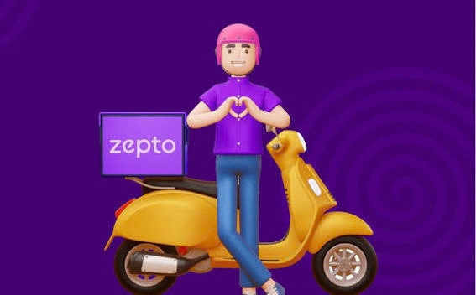
Strong convenience positioning
  Zepto is associated with quick delivery and easy access to everyday essentials.
  Expansion into additional product categories can help position Zepto as an everyday shopping platform
Customer Reviews & Sentiment
  Positive themes to investigate: convenience, time savings, easy ordering and delivery speed.
  Negative themes to investigate: missing items, refund delays, product freshness and customer support.
  Key finding: Analyse whether complaints are isolated incidents or recurring patterns across locations
  Category expansion
  Increasing competition
  Profitability focus
Current Market Trends
Strategic Recommendations
  Improve order accuracy
  Improve unit economics
  Increase customer retention

Slide 17






THANK YOU
FOR JOINING ME TODAY TO EXPLORE THE EXCITING TRENDS SHAPING THE FUTURE OF E-COMMERCE.

